Slide 1


Social Buzz

Slide 2


Today's agenda
Project recap
Problem
The Analytics team
Process
Insights
Summary

Slide 3

An audit of their big data practice
Recommendations for a successful IPO
An analysis of their content categories that highlights the top 5 categories with the largest aggregate popularity
Project Recap

Slide 4

Problem
To analyze their content categories that highlights the top 5 categories with the largest aggregate popularity

Slide 5



Michelle Grove
The Analytics team
Marcus Rompton
Andrew Fleming

Slide 6
Process
1
Data Understanding
2
Data Cleaning
3
Data Modelling
4
Data Analysis
5
Uncover Insights

Slide 7
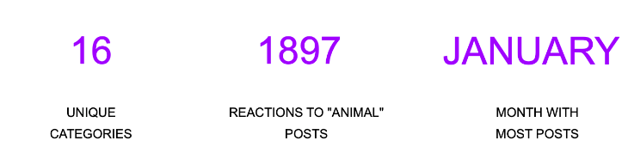

Insights

Slide 8
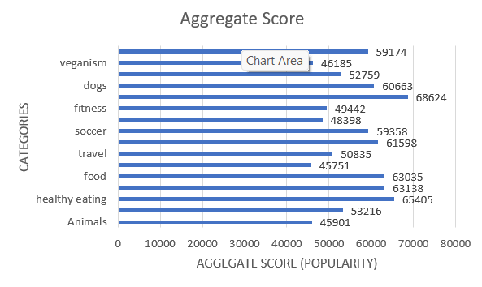

Slide 9
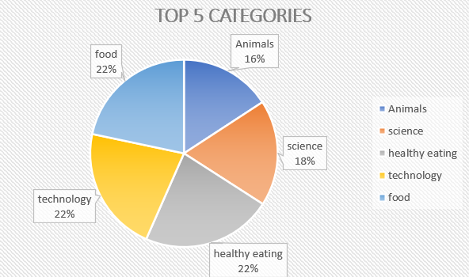

Slide 10

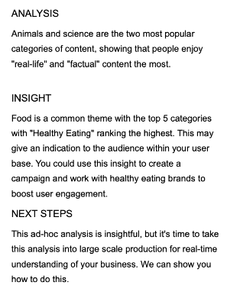
Summary

Slide 11
Thank you!
ANY QUESTIONS?

